Slide 1


Réunion Internationale des Laboratoires et Experts des Matériaux TC 281-CCC: Carbonation of concrete with SCM
WG4: Effect of combined actions: load + carbonation
The 3rd Meeting of WG4
China Building Materials Academy
August, 2020

Slide 2

Réunion Internationale des Laboratoires et Experts des Matériaux TC 281-CCC: Carbonation of concrete with SCM
WG4: Effect of combined actions: load + carbonation
The 3rd Meeting of WG4
China Building Materials Academy
27 August, 2020

Slide 3
Agenda of the 3rd WG4 meeting (Draft)
Welcome address and opening of the WG 4 meeting of RILEM TC 281- CCC;
Self-introduction of each participant and Group photo (screenshot);
Approval of the agenda;
Approval of the minutes of the 2nd WG 4 Meeting;
Brief review on progress of ongoing work of WG 4;
Reports and discussion on the test results of the first test series of 7 labs;
Discussion on test results;
Possible modifications of the test program;
Discussion on detailed plan of the second test series;
Discussion of the contents of the summary report of WG4;
Next meetings;
Next steps and any other business;
Closure of the meeting.

Slide 4
The minutes of the 2nd WG4 Meeting
Time | 17:30-19:00, Sep. 17th, 2019
Venue | Club D at the Prague Convention Center, Prague, Czech Republic Lobby of the Holiday Inn PCC
Main Subjects | Discussion on the annotated bibliography Discussion on loading device setup Inter-laboratory comparative test Next steps
Participants | Altogether 11 persons attended the meeting: Nele De Belie, Philip Van den Heede, Ivan Ignjatovic, Charlotte Thiel, Didier Snoeck, Ling Wang, Juan Li, Zhendi Wang, Hao Wu, Yin Cao, Zengfeng Zhao
Moderator | Juan Li

Slide 5
The minutes of the 2nd WG4 Meeting
1. The annotated bibliography
34 related papers have been collected, 12 of which are about gas permeability of concrete under mechanical load and the other 22 are about carbonation of concrete under mechanical load.
All the 34 publications have been well compiled and the English abstracts were added for the 13 papers written in Chinese.
Prof. Folker H. Wittmann wrote a foreword to each Chapter, comments to the related researches.
The annotated bibliography has been sent to the WG4 members by email on Sep. 15, and comments are welcome.
All the WG4 members are asked to provide any missing publications.
It was planned to publish the annotated bibliography before December 2019.

Slide 6
The minutes of the 2nd WG4 Meeting
2. The loading device setup
It was decided that the work of WG4 starts from the combination of carbonation and compressive load.
The aim of the first round of comparative test is to validate the accuracy and stability of established test setup and to get a general idea of the influence of compressive load on carbonation.
It is better to reduce the dimension of the specimen so that the carbonation chamber can contain the loading device with specimen. CBMA will calculate the minimum height of the specimen and then inform all members to prepare the loading device accordingly before Oct. 10.

Slide 7
The minutes of the 2nd WG4 Meeting
3. The first round of comparative test
(1) Concrete mix. Only one mix shall be considered in the first round of comparative test. CEM I type cement will be used to shorten the curing time to 28 days. The slump of 12 cm is recommended. CBMA will provide a mix proportion based on some pre-testing to avoid segregation before Sep. 30.
(2) Concrete specimens. 3 cubic specimens are needed to test the 28 days’ compressive strength. 9 prism specimens are needed, 3 of which are used to test the compressive strength, 3 for the carbonation test with load and 3 without. If available, more specimens can be made for additional test, e.g. 3 days’ compressive strength, 7 days’ compressive strength and MIP test.
(3) Curing. Immersing the specimens in tap water saturated with Ca(OH)₂ at a temperature of 20°C till 7 days first, and preconditioning in a chamber at a RH of 60% ± 5% and a temperature of 20 °C ± 2 °C till 28 days.

Slide 8
The minutes of the 2nd WG4 Meeting
3. The first round of comparative test
(4) Load condition. The pre-defined compressive stress ratio is 0.45.
(5) CO₂ concentration: 2%.
(6) Carbonation duration: 28 days.
(7) Parameter: carbonation depth. More parameters can be obtained if possible.
(8) 4 laboratories confirmed to carry out the comparative test. More participants are welcome.
NO. | Leader | Lab | First round test
1 | Yan Yao | The State Key Laboratory of Green Building Materials, CBMA, China | YES
2 | Nele De Belie | Magnel Laboratory for Concrete, Ghent University, Belgium | YES
3 | Ivan Ignjatovic | Laboratory of materials, University of Belgrade, Serbia | YES
4 | Siham Kamali-Bernard | Laboratory of Civil and Mechanical Engineering, INSA-Rennes, France | YES

Slide 9
The minutes of the 2nd WG4 Meeting
4. Next steps
Time | Tasks
Sep. 30, 2019 | CBMA will provide a mix proportion for the first series of comparative test.
Oct. 10, 2019 | CBMA will calculate the minimum height of the specimen and then inform all the members to prepare the loading device accordingly. Members should decide whether they will join the first round of comparative test and reply.
Oct. 20, 2019 | Send more relative publications and the comments on the Annotated Bibliography to Dr. Yin CAO.
Oct. 2019 | Determine the comparative test plan. Start the first round of comparative test.
Dec. 2019 | Publish the annotated bibliography.
Jan. 2020 | Compare the test result of the first comparative test.
Feb. 2020 | Start the second round of comparative test.
Aug. 2020 | 3rd WG4 meeting in Sheffield, UK.

Slide 10
The agenda of the 3rd WG4 Meeting
Welcome address and opening of the WG 4 of RILEM TC 281- CCC WG4;
Self-introduction of each participant;
Approval of the agenda (B);
Approval of the minutes of the 2nd WG 4 Meeting (A);(10 min)
Brief review on progress of ongoing work of WG 4; (5 min)
Reports and discussion on the test results of the first test series of 7 labs;（70 min）
Discussion on test results; (15 min)
Possible modifications of the test program (C); (10 min)
Discussion on detailed plan of the second test series; (10 min)
Discussion of the contents of the summary report of WG4; (3 min)
Next meetings;
Next steps and any other business;
Closure of the meeting.

Slide 11
Réunion Internationale des Laboratoires et Experts des Matériaux TC 281-CCC: Carbonation of concrete with SCM
WG4: Effect of combined actions: load + carbonation
The recent progress of WG4
Juan LI
China Building Materials Academy
August, 2020

Slide 12
Outline
Recruitment of members
The progress of the first round of comparative test
The status of the annotated bibliography

Slide 13
1. Recruitment of members
23 members from 7 countries.
NO. | Name | Country | Organization | Notes (Information missing)
1 | BERNAL Susan A. | UK | University of Leeds
2 | CAO Yin | China | China Building Materials Academy
3 | DE BELIE Nele | Belgium | Ghent University
4 | IGNJATOVIC Ivan | Serbia | University of Belgrade
5 | JIN Zuquan | China | Qingdao University of Technology
6 | KAMALI-BERNARD Siham | France | INSA - RENNES | Profile
7 | KANELLOPOULOS Antonis | UK | University of Hertfordshire | Photo
8 | LI Bin | China | China Building Materials Academy | Profile
9 | LI Juan | China | China Building Materials Academy
10 | LIU Zhiyuan | Belgium | Ghent University | Profile
11 | LU Jingzhou | China | Yantai University
12 | OLONADE Kolawole | Nigeria | University of Lagos
13 | PHUNG Quoc Tri | Belgium | Belgian Nuclear Research Centre
14 | SHI Xinyu | China | China Building Materials Academy
15 | TALAKOKULA Visalakshi | India | Bennett University | Photo
16 | VAN DEN HEEDE Philip | Belgium | Ghent University
17 | WANG Jianwei | China | Yantai University | Profile
18 | WANG Ling | China | China Building Materials Academy
19 | WANG Zhendi | China | China Building Materials Academy
20 | XIONG Chuansheng | China | Qingdao University of Technology, | Profile
21 | YAO Yan | China | China Building Materials Academy
22 | YE Jianqiao | UK | Lancaster University
23 | ZHANG Cheng | China | China Building Materials Academy

Slide 14
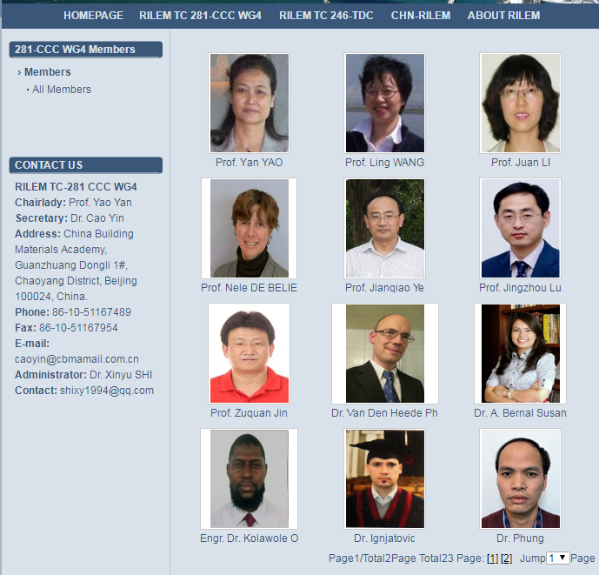
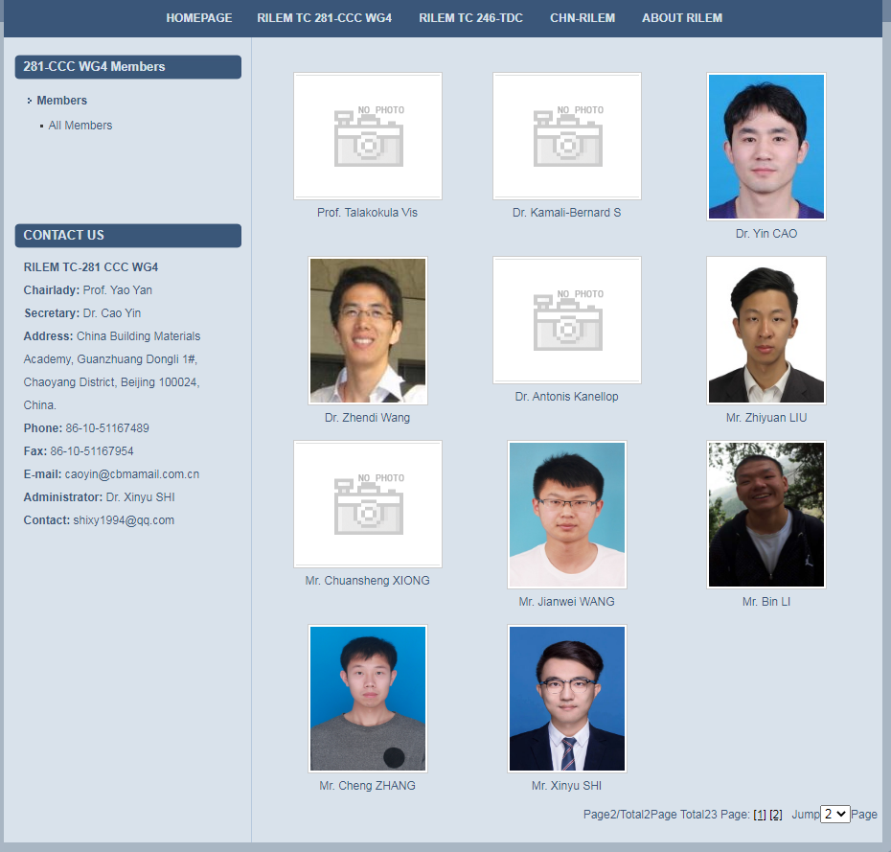
1. Recruitment of members
An email was sent to several members of WG4 on Dec. 4, 2019, asking for their personal information.
The detailed information is now on the website www.rilem.cn www.rilem.cn/page/Default.asp?pageID=170&keyword=&page=1.
However, some colleagues’ information needs to be added.
The website construction is still going on.

Slide 15
2. The progress of the first round of comparative test
The WG4 members had an in-depth discussion at 2nd WG4 Meeting in Prague, Czech Republic on Sept. 17, 2019.
After the 2nd WG4 Meeting, a detailed test plan was proposed and distributed to all members of WG4 on Oct.10, 2019.
The drawings for the compressive test rig was sent to all members of WG4 on Oct. 21, 2019.

Slide 16
2. The progress of the first round of comparative test
7 labs confirmed to join the first round of the comparative test.
NO. | Leader | Lab | Status
1 | Yan Yao | The State Key Laboratory of Green Building Materials, CBMA, China | Finished
2 | Nele De Belie | Magnel Laboratory for Concrete, Ghent University, Belgium | Finished
3 | Ivan Ignjatovic | Laboratory of materials, University of Belgrade, Serbia | Delayed
4 | Siham Kamali-Bernard | Laboratory of Civil and Mechanical Engineering, INSA-Rennes, France | Delayed
5 | Jingzhou Lu | Yantai University, China | Curing, device modification
6 | Talakokula Visalakshi | Bennett University, India | Finished (update on Aug. 24)
7 | Zuquan Jin | Qingdao University of Technology, China | 28d Curing till Aug. 27
Due to COVID-19, experimental work is delayed in some labs.
Notes:
An email was sent to the leader of the 7 lab for inquiry for the progress of the comparative test on July 6, 2020.
A second email was sent to ask for the progress of the comparative test on Aug. 18, 2020.

Slide 17
3. The status of the annotated bibliography
A draft of the annotated bibliography was distributed to all WG4 members in Setp.2019.
Several very valuable comments and suggestion were received. The book has been greatly revised and perfected.
A new structure was applied for each subchapters (gas permeability + load & carbonation + load) : 1. Introduction remarks, 2. Selected papers, 3. Summary.
A summarizing table was added in each summary section to giving a well-structured overview on the key parameters of the test methods and key conclusions as described in each selected paper.
For all selected papers, Photos/figures/schematics related to the test method were added in addition to the original abstract for all selected papers.

Slide 18

3. The status of the annotated bibliography
6 new publications on gas permeability and load, 11 publications on carbonation and load, were added.
The finalized Annotated Bibliography was sent to all members on Aug. 18, 2020 to ask for comments before Aug. 24, 2020.
48 related papers
18 on gas permeability + load
30 on carbonation + load
ISBN and DOI is ready.
ISBN: 978-3-942052-09-2
DOI: 10.12900/B20-0001

Slide 19
Thanks for your attention !

Slide 20
Reports and discussion on the test results of the first test series of 7 labs
（For UGent and CBMA, including the progress on the International Cooperation Project of NSFC & FWO）
- Ghent University, Belgium (20 min)
- China Building Materials Academy, China (20min)
- Bennett University, India (5 min)
- University of Belgrade, Serbia (15 min)
- INSA – RENNES, France (5 min)
- Qingdao University of Technology, China (5 min)
- Yantai University, China (5 min)

Slide 21
Discussion on test results
Discussion
1. Compressive load has an effect on the carbonation depth of concrete, but strongly depends on the real stress level. More attention should be paid to the load application and its monitoring.
2. Carbonation depth of different surface may differs a lot. Carbonation depths of troweled surface are more than bottom cast surface, no matter 45% load is applied or not.
3. For OPC concrete, curing age affects the carbonation depth.
4. Different CO₂ concentration,

Slide 22
Possible modifications of the test program
Discussion
1. Since carbonation depth of concrete is strongly affected by the real stress level, it is recommended to monitor the applied load in real-time.
2. Shall we consider the different surfaces during carbonation test?
3. Lime curing or not?
4. Deviation of labs, standardize the procedure
5. 1 hour or 24 hours, or both

Slide 23
Discussion on detailed plan of the 2nd test series
Scope and Applications
Equipment
Materials and Mix Design
Preparation of Test Samples
Schedule

Slide 24
Discussion on detailed plan of the 2nd test series
1. Scope and Applications
Scope
To determine durability of concrete with SCMs under combined actions of carbonation and compressive load.
Applied compressive load
Carbonation and compression simultaneously.
The pre-defined compressive stress ratios for this second round of comparative testing are 0.30, 0.60 (0.80 optional). A comparison will be made with the unloaded condition.
3 specimens for each stress ratio.

Slide 25
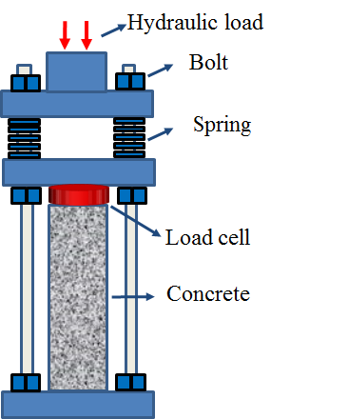
Discussion on detailed plan of the 2nd test series
2. Equipment
Loading device
Using a bolt-and-spring system
Carbonation chamber
Temperature: 20 ± 2 ℃
Relative humidity: 65 ± 5%
CO₂ concentration: 0.035%, 2% and 20%
Size: at least 9~12 specimens with loading device

Slide 26
Discussion on detailed plan of the 2nd test series
3. Materials and Mix Design
Mix proportion
Cement type: CEM I 42.5
FA: 30% substitution of cement
BFS: 50% substitution of cement
Superplasticizer: Polycarboxylates superplasticizer, adjust the amount to make the slump of 110±10 mm.
NO | Cement (kg/m³) | w/c | SCMs | Water (kg/m³) | Fine aggregate (kg/m³) | Coarse aggregate (kg/m³) | Superplastizer (kg/m³) | Slump (mm)
RF | 330 | 0.6 | 0 | 198 | 719 | 1162 | (As needed) | 110
FA | 231 | 0.6 | 99 | 198 | 719 | 1162 | (As needed) | 110
BFS | 165 | 0.6 | 165 | 198 | 719 | 1162 | (As needed) | 110

Slide 27
Discussion on detailed plan of the 2nd test series
4. Preparation of Test Samples
Concrete specimen
Plain concrete without reinforcement.
Number: At least 3 cubes and 21 prisms (100×100×300 mm³) for one series (one concrete mix).
Group I: 3 cubes for compressive strength test (f_{cc});
Group II: 3 prisms for compressive strength test (f_{cp});
Group III: 18 for carbonation with the stress ratio 0, 0.3, 0.6, (0.8), CO₂ concentration 2% and 20%. (3 stress ratio, 2 CO₂ concentration, triplicate)
GROUP III | Specimens (2% CO₂) | Specimens (20% CO₂)
RF | RF-0-2%, RF-0.3-2%, RF-0.6-2% | RF-0-20%, RF-0.3-20%, RF-0.6-20%
FA | FA-0-2%, FA-0.3-2%, FA-0.6-2% | FA-0-20%, FA-0.3-20%, FA-0.6-20%
BFS | BFS-0-2%, BFS-0.3-2%, BFS-0.6-2% | BFS-0-2%, BFS-0.3-20%, BFS-0.6-20%

Slide 28
Discussion on detailed plan of the 2nd test series
4. Preparation of Test Samples
Curing
Procedure of the curing | Group Ⅰ | Group Ⅱ | Group Ⅲ
Test aim for each group | 3 cubes for compressive strength test (f_{cc}) | 3 prisms for compressive strength test (f_{cp}) | 18 for carbonation test with and without load
Curing in the moulds, air temperature of 20 (±2) ℃, covering with a plastic sheet. | 1 day | 1 day | 1 day
In saturated Ca(OH)₂ solution at 20 (±2) ℃. | 6 days | 6 days | 6 days
In climate chamber at 20 (±2) ℃ and 65 (±5) % RH. | 84 days | 84 days | 84 days
In carbonation chamber at predefined CO₂ concentration, 20 ℃ and 65 (±5) % RH. | -- | -- | 28 days
Note: Only for one mix. For Group III, 3 stress ratio, 2 CO₂ concentration, triplicate.

Slide 29
Discussion on detailed plan of the 2nd test series
DOODLE |  |  |  |  |  |  |  |  |  |  | Additional
CO₂ | MIX | Stress ratio | Label | CBMA | UGent | Belgrade U. | Qingdao Tech. | INSA | Yantai U. | Bennett U. | Stress ratio (0.8) | MIX
2% | RF | 0.0 | RF-0-2%
 |  | 0.3 | RF-0.3-2%
 |  | 0.6 | RF-0.6-2%
 | FA | 0.0 | FA-0-2%
 |  | 0.3 | FA-0.3-2%
 |  | 0.6 | FA-0.6-2%
 | BFS | 0.0 | BFS-0-2%
 |  | 0.3 | BFS-0.3-2%
 |  | 0.6 | BFS-0.6-2%
20% | RF | 0.0 | RF-0-20%
 |  | 0.3 | RF-0.3-20%
 |  | 0.6 | RF-0.6-20%
 | FA | 0.0 | FA-0-20%
 |  | 0.3 | FA-0.3-20%
 |  | 0.6 | FA-0.6-20%
 | BFS | 0.0 | BFS-0-20%
 |  | 0.3 | BFS-0.3-20%
 |  | 0.6 | BFS-0.6-20%

Slide 30
Discussion on detailed plan of the 2nd test series
5. Schedule
Time | Tasks
2020.09 | Finalize the test program of the second round comparative test
2020.09-2021.02 | Second round comparative test (Curing for 3 months + Carbonation for 1 month). Casting & Curing: 2020.10-2021.01 Carbonation: 2021.01-2021.02
2021.03.22-03.26 | 4th WG4 pre-meeting before RILEM 75th Anniversary (Paris, France, 6 to 10 April 2021) 2021.03.23, possible date

Slide 31
Next meetings
Time | Tasks
Mar. 2021 | 4th WG4 meeting in Paris, France in conjunction with 75 years celebration of RILEM (6 to 10 April 2021) Discussion of the test results of the second round comparative test

Slide 32
Next steps and any other business
Next steps
1.
2.

Slide 33
Closure of the meeting

Slide 34
Thanks for your cooperation!

Slide 35
Possible modifications of the test program
Scope and Applications
Equipment
Materials and Mix Design
Preparation of Test Samples
Test Procedure
Report

Slide 36
Possible modifications of the test program
1. Scope and Applications
Scope
To determine durability of concrete under combined actions of carbonation and compressive load.
Applied compressive load
Carbonation and compression simultaneously.
The pre-defined compressive stress ratio for this first round of comparative testing is 0.45. A comparison will be made with the unloaded condition.

Slide 37
Possible modifications of the test program
2. Equipment
Loading device
Using a bolt-and-spring system
Carbonation device
Temperature: 20 ± 2 ℃
Relative humidity: 65 ± 5%
CO₂ concentration: 2% or 20%
Please note that the carbonation chamber should accommodate at least 9 specimens with loading device (in the second round of comparative test, at least 3 stress ratios 0, 0.30, 0.60 will be considered and 3 specimens for each stress ratio).
In the first comparative test, only CO₂ concentration of 2% is considered.
In the second round of comparative test, natural carbonation and CO₂ concentration of 20% will be also considered.

Slide 38
Possible modifications of the test program
3. Materials and Mix Design
Mix proportion
Cement type: CEM I 42.5
Superplasticizer: Polycarboxylates superplasticizer, adjust the amount to make the slump of 110±10 mm.
Cement (kg/m³) | w/c | Water (kg/m³) | Fine aggregate (kg/m³) | Coarse aggregate (kg/m³) | Superplastizer (kg/m³) | Slump (mm)
330 | 0.6 | 198 | 719 | 1162 | (As needed) | 110

Slide 39
Possible modifications of the test program
4. Preparation of Test Samples
Concrete specimen
Plain concrete without reinforcement.
Number: At least 3 cubes and 9 prisms (100×100×300 mm3) in one series. The height of the prisms is determined from stress analysis (See the next page).
Group I: 3 cubes for compressive strength test (f_{cc});
Group II: 3 prisms for compressive strength test (f_{cp});
Group III: 3 for carbonation with the stress ratio 0.45 and 3 for carbonation without load.
If available, more specimens can be made for additional test.

Slide 40
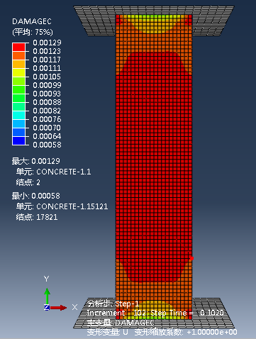
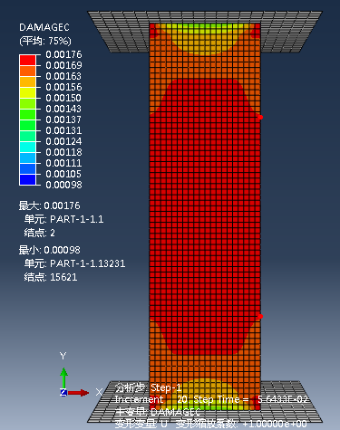
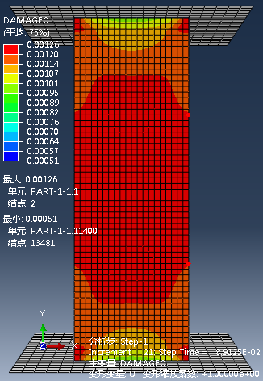
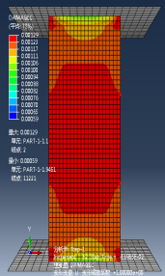
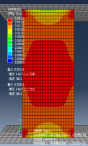
Possible modifications of the test program
4. Preparation of Test Samples
Concrete specimen
Specimens with dimension of 100×100×300 mm³ is recommended.
Stress analysis results of prisms with different height (cross section 100×100 mm²)
Height of prisms (mm) | 200 | 250 | 300 | 350 | 400
Compression Damage Nephogram (at 0.80 stress level)
Height of the stress- uniformly distributed-area (mm) | 30 | 90 | 130 | 180 | 240

Slide 41
Possible modifications of the test program
4. Preparation of Test Samples
Casting
All specimens are cast and compacted on a vibrating table in accordance with the procedure described in ISO 1920-3 or EN 206.
Casting direction for the prismatic samples: horizontal.

Slide 42
Possible modifications of the test program
4. Preparation of Test Samples
Curing
Procedure of the curing | Group Ⅰ | Group Ⅱ | Group Ⅲ
Test aim for each group | 3 cubes for compressive strength test (f_{cc}) | 3 prisms for compressive strength test (f_{cp}) | 6 for carbonation test with and without load
Curing in the moulds, air temperature of 20 (±2) ℃, covering with a plastic sheet. | 1 day | 1 day | 1 day
In saturated Ca(OH)₂ solution at 20 (±2) ℃. | 6 days | 6 days | 6 days
In climate chamber at 20 (±2) ℃ and 65 (±5) % RH. | 21 days | 21 days | 21 days
In carbonation chamber at predefined CO₂ concentration, 20 ℃ and 65 (±5) % RH. | -- | -- | 28 days
In the second round of comparative test, CEM III/B (or CEM I + Fly ash) concrete will be tested. For CEM III/B(or CEM I + Fly ash) concrete, longer curing period is needed before carbonation test, i.e. 7d of optimal curing in saturated Ca(OH)₂ solution (lime water) followed by 84 days of curing at at 20 (±2) ℃ and 65 (±5) % RH.

Slide 43
Possible modifications of the test program
4. Preparation of Test Samples
Preconditioning
For the loaded specimens (3 specimens in Group III)
Smooth the middle of the upper and lower surfaces for pasting the strain gauges.
Fix the strain gauges symmetrically in the middle of the both sides on the purpose of monitoring the strain of the specimen.
Cover the two surfaces with 2 layers of aluminum foil.
Apply the compressive load with the loading set-ups.
For the unloaded specimens (3 specimens in Group III)
Cover the upper and lower surfaces with 2 layers of aluminum foil.
Leave the other 2 opposite demoulded surfaces open for CO₂ ingress.

Slide 44
Possible modifications of the test program
5. Test Procedure
For Group I, test the 28 d compressive strength of cubes (f_{cc}).
For Group II, test the compressive strength of prisms (f_{cp}) .
Put all the specimens of Group III (after preconditioning) in the carbonation device till the carbonation duration.
Test the 28 d carbonation depth of the specimens (See the next page).
In the second round of comparative test, additional tests can be done to investigate the loading-induced damage on the micro-scale, changes in chemical composition due to carbonation, etc.

Slide 45
Possible modifications of the test program
5. Test Procedure--Carbonation depth test
Split the concrete prisms to make two halves.
Spray with indicator solution of 1% phenolphthalein in 80% ethyl alcohol on the two new surfaces.
After 30 seconds, take a photo of the two surfaces.
Draw 8 parallel lines on the photo of the two new surfaces with a distance of 10 mm.
Determine the carbonation depth along the parallel lines.
Determine the average carbonation depth from the carbonation depths indicated by the 8 parallel lines.
Take the average carbonation depth of 3 specimens as the carbonation depth.

Slide 46
Possible modifications of the test program
6. Report
The test report shall contain at least the following information:
(1) Raw materials and composition of the concrete.
(2) Specification of the loading and the carbonation device.
(3) Number and size of specimens.
(4) Applied load, climatic conditions for carbonation.
(5) Test results.
(6) Deviation from the procedure as described in this method, if any.

