Slide 1

Réunion Internationale des Laboratoires et Experts des Matériaux
TC 281-CCC: Carbonation of concrete with SMC
WG4: Effect of combined actions: load + carbonation
A Detailed Description of the Comparative Test Method
—for the first round of comparative test
Oct. 10, 2019

Slide 2
OUTLINE
Scope and Applications
Equipment
Materials and Mix Design
Preparation of Test Samples
Test Procedure
Report
Notes:
The work is going forward well.
工作进展顺利。
The work progressed very successfully.
工作进展得十分顺利

Slide 3
1. Scope and Applications
Scope
To determine durability of concrete under combined actions of carbonation and compressive load.
Applied compressive load
Carbonation and compression simultaneously.
The pre-defined compressive stress ratio for this first round of comparative testing is 0.45. A comparison will be made with the unloaded condition.
For the second round of comparative testing other compressive stress ratios to consider are 0.30 and 0.60. If available, stress ratio of 0.80 can be also considered.

Slide 4
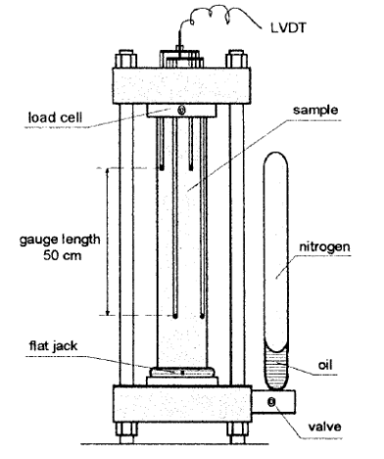
2.1 Loading device
2. Equipment
The compressive load shall be applied on a prismatic concrete specimen using a test rig similar to test rigs used for creep loading and described in RILEM recommendation of TC 107-CSP (Fig. 1).
Different loading rigs are presented for the creep tests, however, the hydro-pneumatic accumulator shown in Fig. 1 is recommended.
Test rigs, which have the same principle and function and fulfil the requirements of RILEM recommendation of TC 107-CSP can be used as well.
All test rigs shall guarantee the stability of the external load during the entire test period.
Figure 1. Schematic representation of test rig for compression

Slide 5
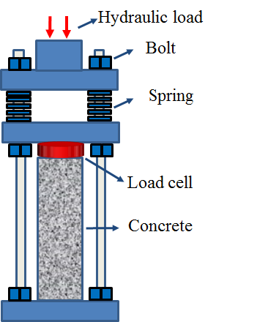
2. Equipment
2.1 Loading device – existing setups
Using a torque wrench
Using a bolt-and-spring system

Slide 6
2. Equipment
2.2 Carbonation device
The following requirements shall be met:
Temperature: 20 ± 2 ℃
Relative humidity: 65 ± 5%
CO₂ concentration: 2% or 20%
Please note that the carbonation chamber should accommodate at least 9 specimens with loading device (in the second round of comparative test, at least 3 stress ratios 0, 0.30, 0.60 will be considered and 3 specimens for each stress ratio).
In the first comparative test, only CO₂ concentration of 2% is considered.
In the second round of comparative test, natural carbonation and CO₂ concentration of 20% will be also considered.

Slide 7
3. Materials and Mix Design
Mix proportion
Table1 Mix proportion for the first comparative test
Cement (kg/m³) | w/c | Water (kg/m³) | Fine aggregate (kg/m³) | Coarse aggregate (kg/m³) | Superplastizer (kg/m³) | Slump (mm)
330 | 0.6 | 198 | 719 | 1162 | (As needed) | 110
Cement type: CEM I 42.5
Super-plasticizer: polycarboxylic admixtures, adjust the amount to make the slump of 110±10 mm.
Please note that in the second round of comparative test, CEM III/B (or CEM I + Fly ash) concrete will be tested.

Slide 8
3. Materials and Mix Design
Pre-test at CBMA
Raw Materials
  (1) Cement: CEM I 42.5
Table 2 Chemical composition of cement (%)
SiO₂ | Al₂O₃ | Fe₂O₃ | CaO | SO₃ | Na₂Oeq | f-CaO | Loss | Cl⁻
22.89 | 4.51 | 3.51 | 62.85 | 2.42 | 0.55 | 0.86 | 0.98 | 0.014
Table 3 Physical properties of cement
Fineness （%） | Density （g/cm³） | Specific surface （m²/kg） | Setting time （min） |  | Flexural strength （MPa） |  | Compressive strength （MPa）
 |  |  | Initial | Final | 3d | 28d | 3d | 28d
0.9 | 3.15 | 340 | 193 | 249 | 5.2 | 9.2 | 25.2 | 50.7

Slide 9
3. Materials and Mix Design
  (2) Fine aggregate
Table 4 Properties of fine aggregate
Apparent density | Bulk density | Fineness modulus
2.68×10³ kg/m³ | 1.59×10³ kg/m³ | 2.9
  (3) Limestone
Table 5 Properties of coarse aggregate
Size | Apparent density | Bulk density | Gradation
5-20 mm | 2.72×10³ kg/m³ | 1.67×10³ kg/m³ | 5~10 mm: 40% by weight 10~20 mm: 60% by weight
  (4) Tap water
  (5) Superplastizer
Table 6 Properties of superplastizer
Type | Water-reducing rate | Solid content
Polycarboxylic admixtures | 29% | 20%

Slide 10
3. Materials and Mix Design
Pre-test at CBMA
Mix proportion
Table 7 Mix proportion used in the pre-test at CBMA
Cement (kg/m³) | w/c | Water (kg/m³) | Fine aggregate (kg/m³) | Coarse aggregate (kg/m³) | Superplastizer (kg/m³) | Slump (mm)
330 | 0.6 | 198 | 719 | 1162 | 0.5 | 110
Compressive strength of cubic samples
3 d compressive strength: 12.3 MPa
7 d compressive strength: 21.2 MPa
28 d compressive strength: TBD

Slide 11
4. Preparation of Test Samples
4.1 Concrete specimen
Plain concrete without reinforcement.
Number: At least 3 cubes and 9 prisms (100×100×300 mm³) in one series. The height of the prisms is determined from stress analysis (See the next page).
Group I: 3 cubes for compressive strength test (f_{cc});
Group II: 3 prisms for compressive strength test (f_{cp});
Group III: 3 for carbonation with the stress ratio 0.45 and 3 for carbonation without load.
If available, more specimens can be made for additional test.

Slide 12
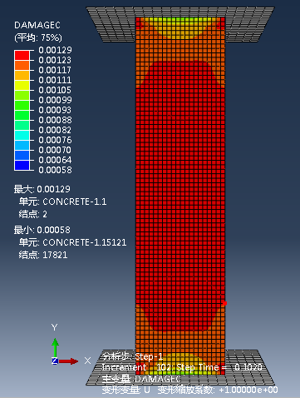
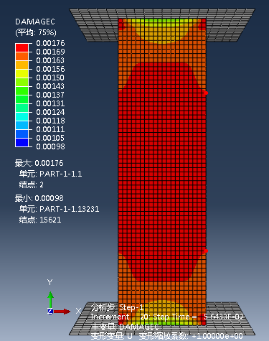
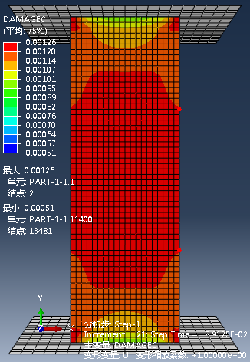
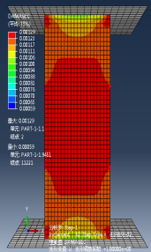
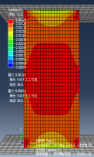
4.1 Concrete specimen
Specimens with dimension of 100×100×300 mm³ is recommended.
Meet the requirement of height-to-width ratio.
Can get enough samples from the stress-uniformly distributed-area for the following testing and analysis after combined action.
Table 8 Stress analysis results of prisms with different height (cross section 100×100 mm²)
Height of prisms (mm) | 200 | 250 | 300 | 350 | 400
Compression Damage Nephogram (at 0.80 stress level)
Height of the stress- uniformly distributed-area (mm) | 30 | 90 | 130 | 180 | 240

Slide 13
4. Preparation of Test Samples
4.2 Casting
All specimens are cast and compacted on a vibrating table in accordance with the procedure described in pr EN-ISO 2736/2.
Casting direction for the prismatic samples: horizontal.

Slide 14
4. Preparation of Test Samples
4.3 Curing
Table 9 Curing process of the concrete specimen in each group
Procedure of the curing | Group Ⅰ | Group Ⅱ | Group Ⅲ
Test aim for each group | 3 cubes for compressive strength test (f_{cc}) | 3 prisms for compressive strength test (f_{cp}) | 6 for carbonation test with and without load
Curing in the moulds, air temperature of 20 (±2) ℃, covering with a plastic sheet. | 1 day | 1 day | 1 day
In saturated Ca(OH)₂ solution at 20 (±2) ℃. | 6 days | 6 days | 6 days
In climate chamber at 20 (±2) ℃ and 65 (±5) % RH. | 21 days | 21 days | 21 days
In carbonation chamber at predefined CO₂ concentration, 20 ℃ and 65 (±5) % RH. | -- | -- | 28 days
In the second round of comparative test, CEM III/B (or CEM I + Fly ash) concrete will be tested. For CEM III/B(or CEM I + Fly ash) concrete, longer curing period is needed before carbonation test, i.e. 7d of optimal curing in saturated Ca(OH)₂ solution (lime water) followed by 84 days of curing at at 20 (±2) ℃ and 65 (±5) % RH.

Slide 15
4. Preparation of Test Samples
4.4 Preconditioning
For the loaded specimens (3 specimens in Group III)
Smooth the middle of the upper and lower surfaces for pasting the strain gauges.
Fix the strain gauges symmetrically in the middle of the both sides on the purpose of monitoring the strain of the specimen.
Cover the two surfaces with 2 layers of aluminum foil.
Apply the compressive load with the loading set-ups.
For the loaded specimens (3 specimens in Group III)
Cover the upper and lower surfaces with 2 layers of aluminum foil.
Leave the other 2 opposite demoulded surfaces open for CO₂ ingress.

Slide 16
5. Test Procedure
For Group I, test the 28 d compressive strength of cubes (f_{cc}).
For Group II, test the compressive strength of prisms (f_{cp}) .
Put all the specimens of Group III (after preconditioning) in the carbonation device till the carbonation duration.
Test the 28 d carbonation depth of the specimens (See the next page).
In the second round of comparative test, additional tests can be done to investigate the loading-induced damage on the micro-scale, changes in chemical composition due to carbonation, etc.

Slide 17
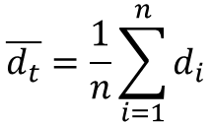
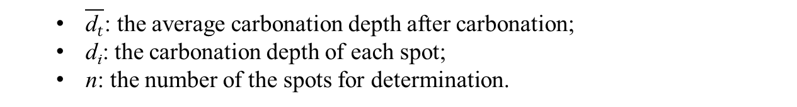
5. Test Procedure
Carbonation depth test
Split the concrete prisms from the middle of the specimens.
Spray with indicator solution of 1% phenolphthalein in 80% ethyl alcohol.
After 30 seconds, determine the carbonation depth of the every 10mm ascertained by the parallel lines drawn at first.
Take the average as the carbonation depth of the specimen.
Take the average carbonation depth of 3 specimens as the carbonation depth.
$$\overline{d_{t}}=\frac{1}{n}\sum_{i=1}^{n}{d_{i}}$$
$\overline{\text{d}t}$: the average carbonation depth after carbonation;
d_{i}: the carbonation depth of each spot;
n: the number of the spots for determination.

Slide 18
6. Report
The test report shall contain at least the following information:
(1) Raw material and composition of the concrete.
(2) Information of the loading device and the carbonation device.
(3) Numbers and size of specimens.
(4) Stress ratio, carbonation environment.
(5) Test results.
(6) Any deviation from the procedure described in this method.

Slide 19
Please kindly send your comments and questions to the secretary of WG4 via caoyinzi@163.com.
Thanks!

